Slide 1
Interference by Feedback Loops: Challenges in the Counterfactual Interleaving Design
Zhihua Zhu (Tencent)
Liang Zheng (Tencent)
Zheng Cai (Tencent)
Nian Si (Stanford → University of Chicago → HKUST)

Slide 2










Testing boosting algorithms via seller-side A/B tests
Treatment
Boost the scores for ads in the treatment group for all users.
Control
Test the effects of boosting sports brands via seller-side A/B tests

Slide 3
Interference in seller-side A/B tests
We boost 50% of sports ads in the seller-side A/B tests.
Ads in the treatment achieve a higher ranking.
If we were to boost all sports ads in the global treatment, the ones in initial treatment group would actually descend in rank.

Slide 4

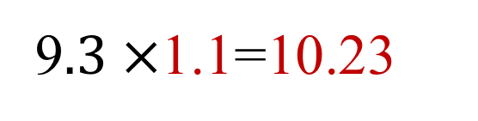
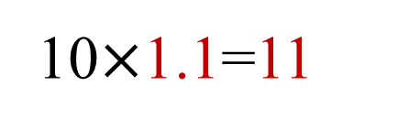
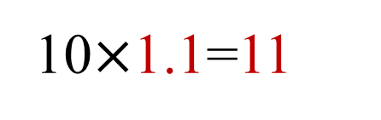
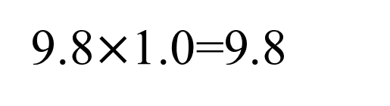
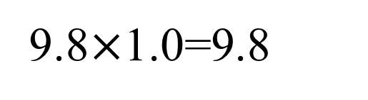
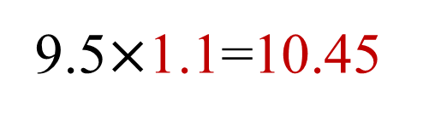
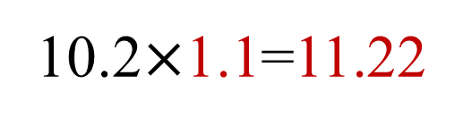
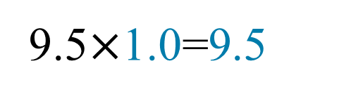
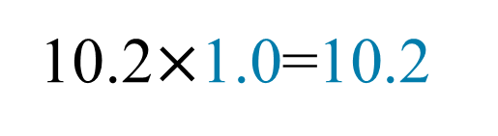
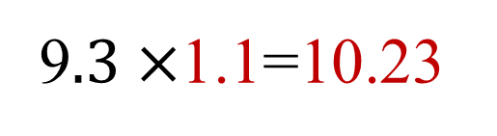
Interference in seller-side A/B tests
10$×$1.1=11
10.2$×$1.1=11.22
Seller-side A/B tests
9$.3×$1.1=10.23
10$×$1.1=11
Global Treatment
9.5$×$1.1=10.45
10.2$×$1.0=10.2
9.8$×$1.0=9.8
9$.3×$1.1=10.23
9.8$×$1.0=9.8
9.5$×$1.0=9.5

Slide 5
Counterfactual interleaving design
Both the control strategy and treatment strategy are applied to rank all ads to obtain Ranking C and Ranking T.
Merge two ranks to obtain the final rank M as
The rank of control ads as in Ranking C;
The rank of treatment ads as in Ranking T;
If position conflicts, resolved randomly.
Proposed in Ha-Thuc et al. [2020], followed up by Nandy et al [2021] and Wang and Ba [2023].

Slide 6
Counterfactual interleaving design
Rank C
A
B
C
D
E
F
Rank M
B
A
C
D
E
F
Rank T
B
C
D
A
E
F

Slide 7
Interference induced by feedback loops
Feedback loops in two-sided marketplaces:
Units may be affected by the previous outcomes in a complex way.
Examples include:
Data training loops;
Pacing algorithms: selling rates in E-commerce, budget consumption rates in ads recommendation, exploration speed in cold start algorithms, etc.

Slide 8
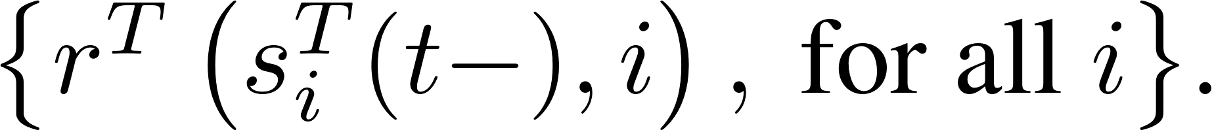
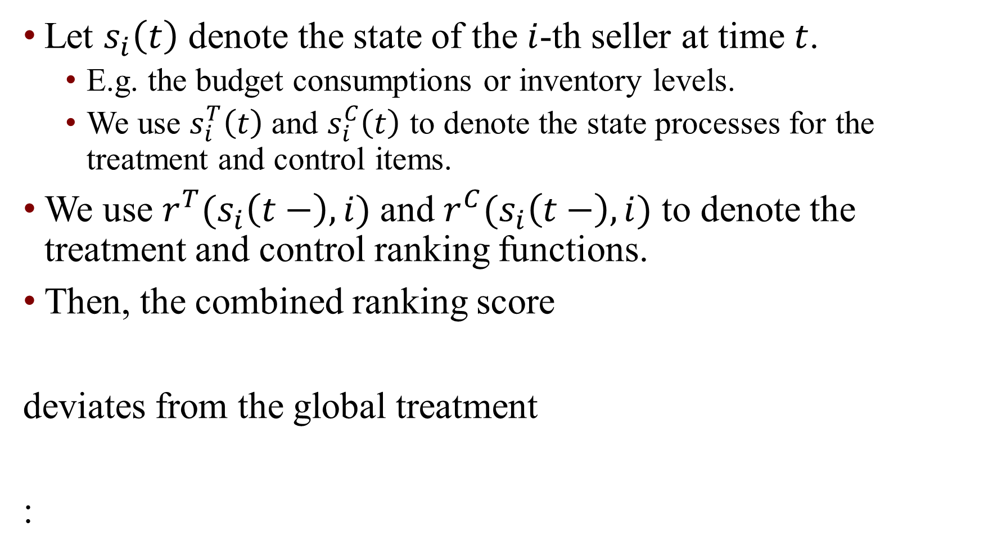
A model for interference induced by feedback loops
Let $s_{i}\left(t\right)$ denote the state of the $i$-th seller at time $t$.
E.g. the budget consumptions or inventory levels.
We use $s_{i}^{T}\left(t\right)$ and $s_{i}^{C}\left(t\right)$ to denote the state processes for the treatment and control items.
We use $r^{T}(s_{i}\left(t−\right),i)$ and $r^{C}(s_{i}\left(t−\right),i)$ to denote the treatment and control ranking functions.
Then, the combined ranking score
deviates from the global treatment
:

Slide 9
Literature: interference induced by feedback loops
Bias correction using past A/B tests [Goli – Lambrecht – Yoganarasimhan, 2023];
Symbiosis Bias [Holtz – Brennan – Pouget-Abadie, 2023]
Data training loops and weighted training [Si, 2023]
Query-randomized experiments [Mansoury et al, 2023]
Testing bandit learning algorithms and two-stage experiments [Guo – Naeff – Nikulkov – Zhu, 2023]

Slide 10
Real-Data Results

Slide 11
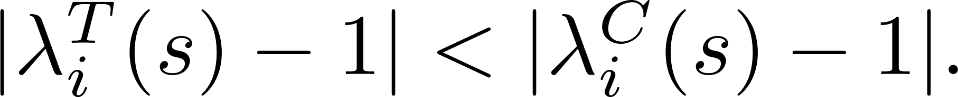
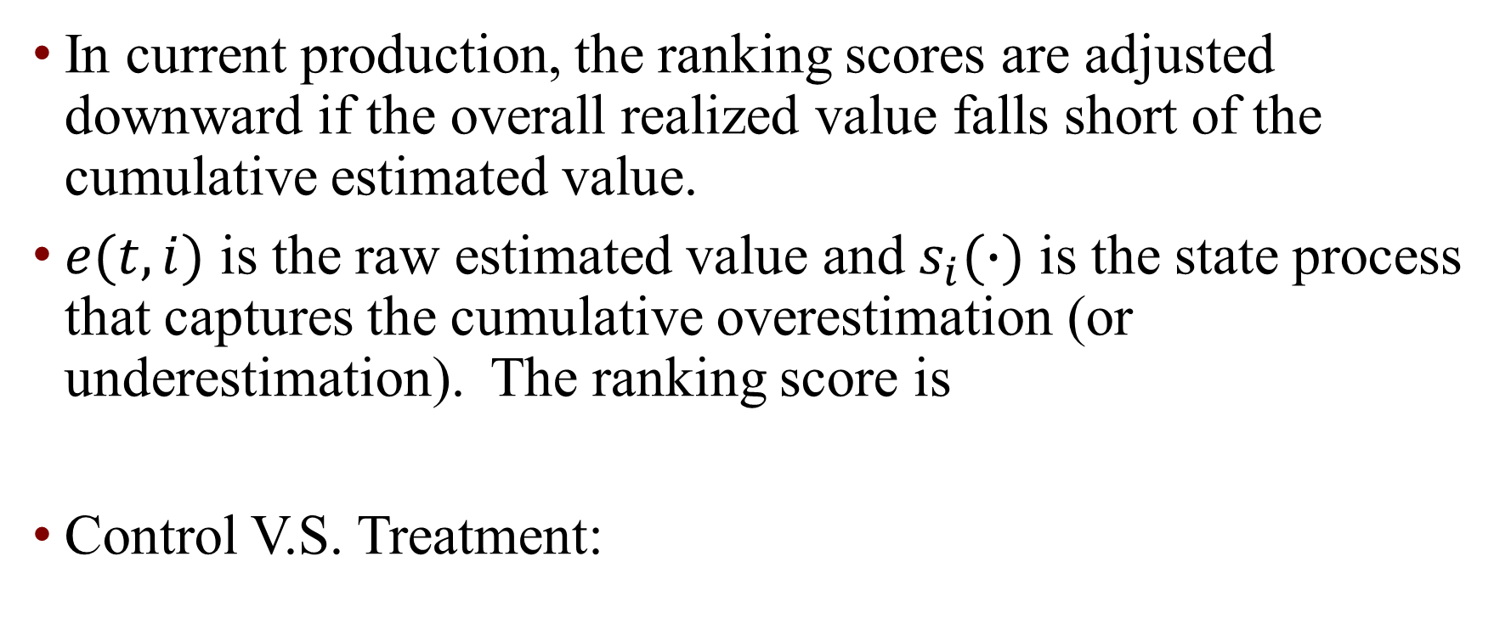
Experiments
In current production, the ranking scores are adjusted downward if the overall realized value falls short of the cumulative estimated value.
$e(t,i)$ is the raw estimated value and $s_{i}(∙)$ is the state process that captures the cumulative overestimation (or underestimation). The ranking score is
Control V.S. Treatment:

Slide 12
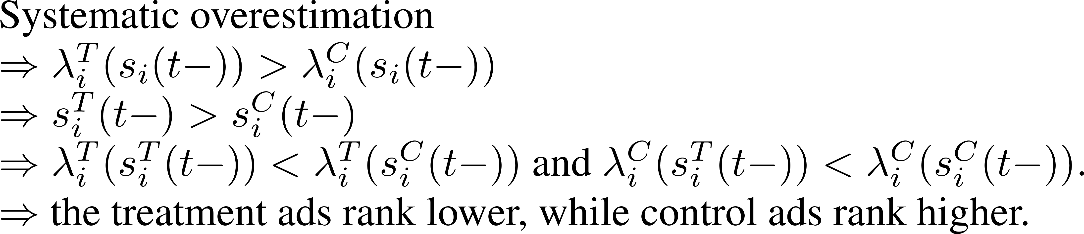
Experimental results and explanations
Despite simulations and A/A tests consistently indicating the superiority of the treatment strategy over the control strategy, the counterfactual interleaving design suggests otherwise.
Potential reason:

Slide 13
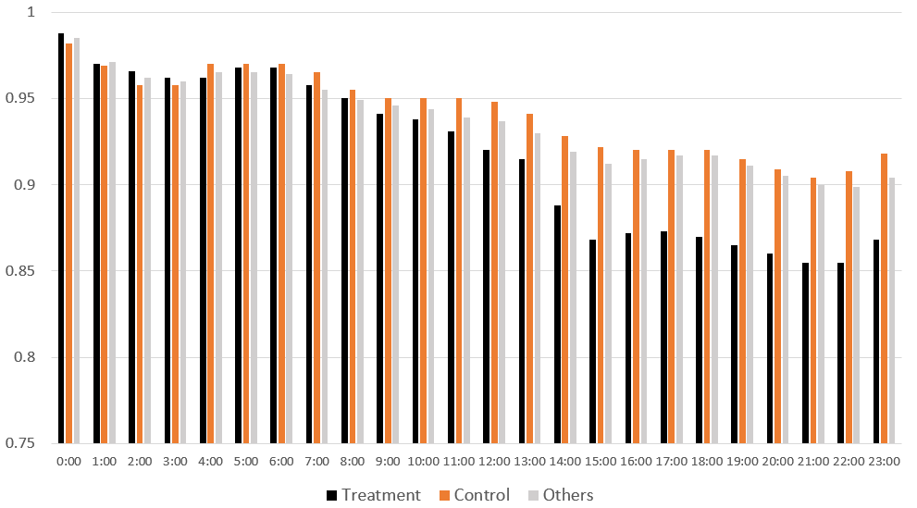
State dynamics
Average $λ^{T}$ values, for the control ads, treatment ads, and other ads over time in a day

Slide 14
Q&A?

